Slide 2
Overview

Slide 3
My journey

Slide 4



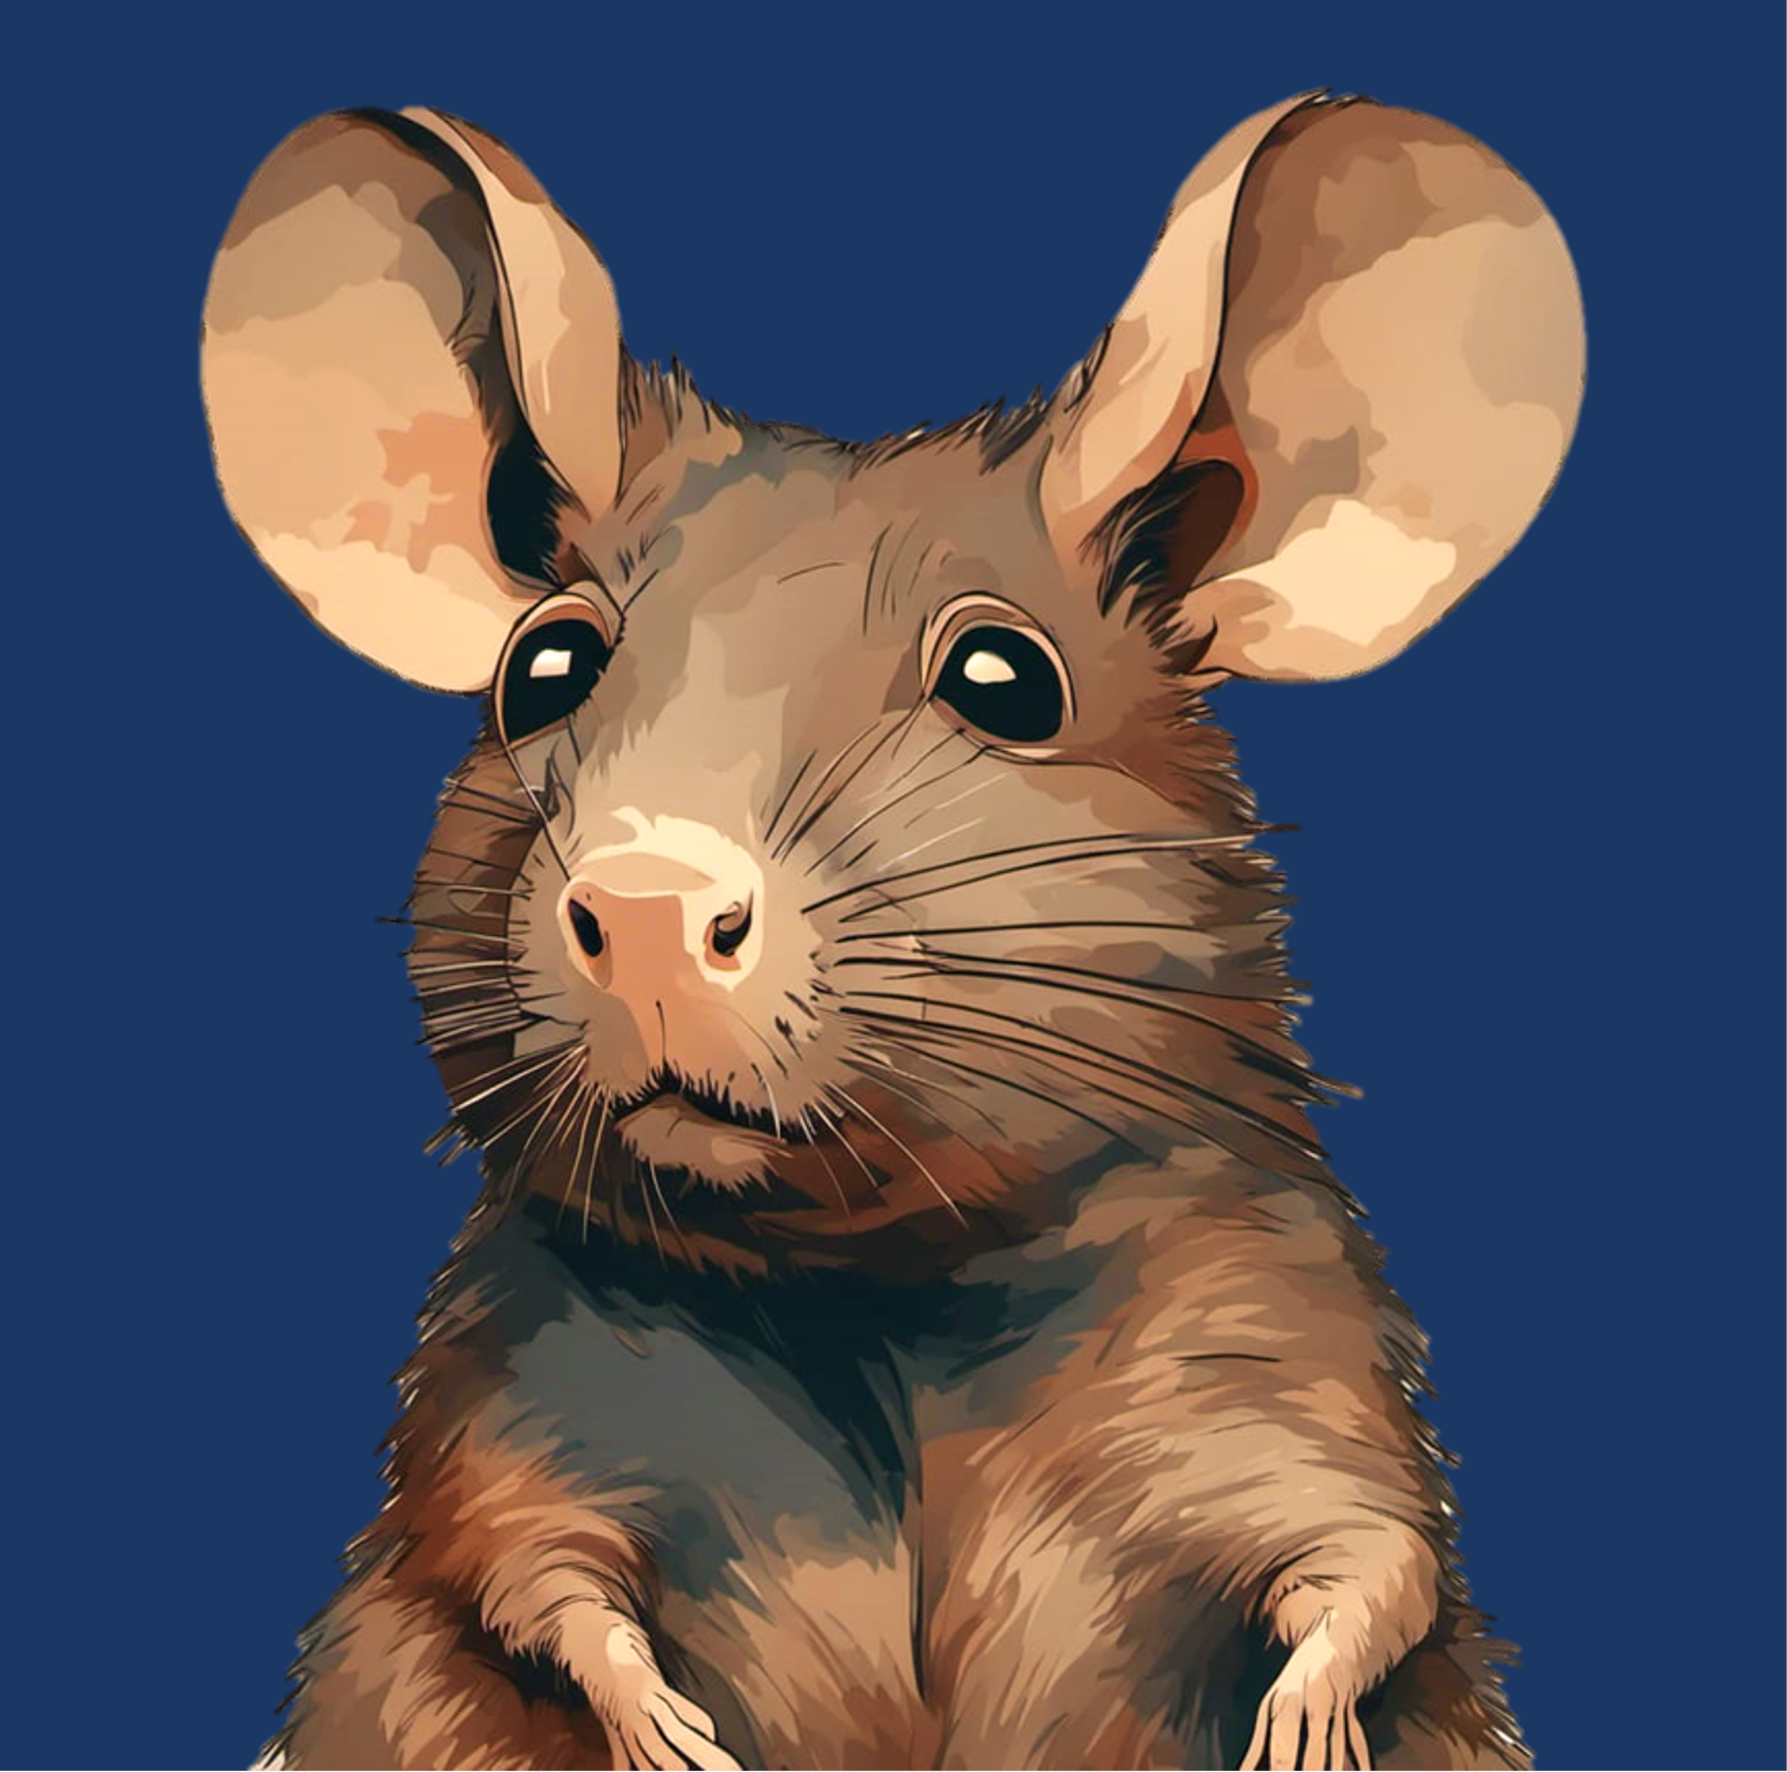



Slide 5
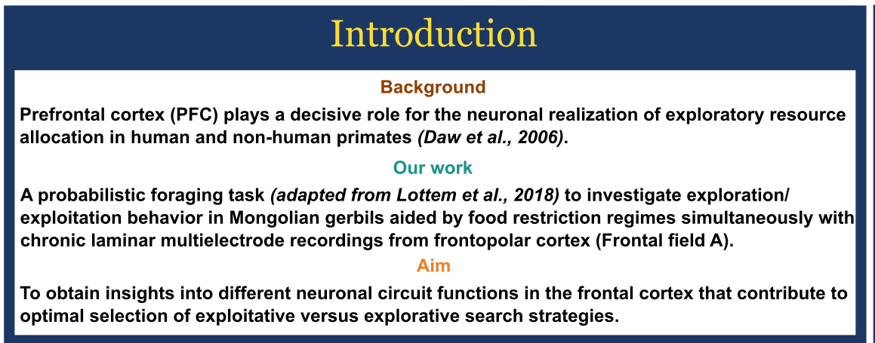
Motivation?

Slide 6
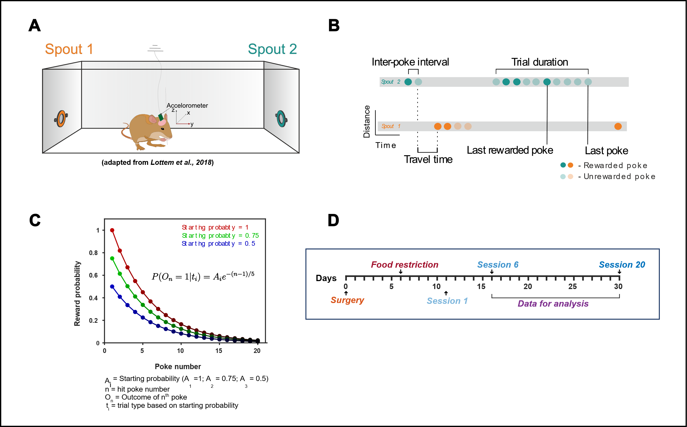
The task

Slide 7
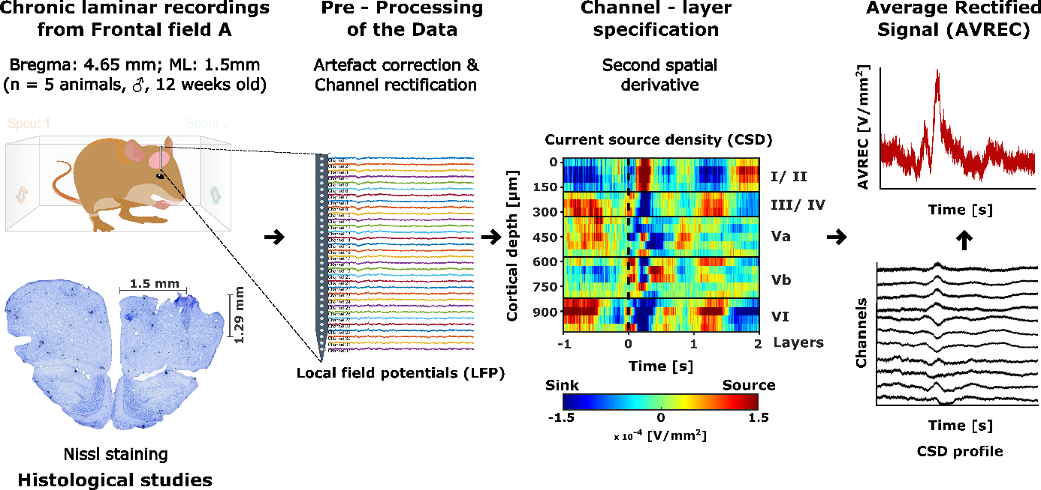
How do we study this?

Slide 8
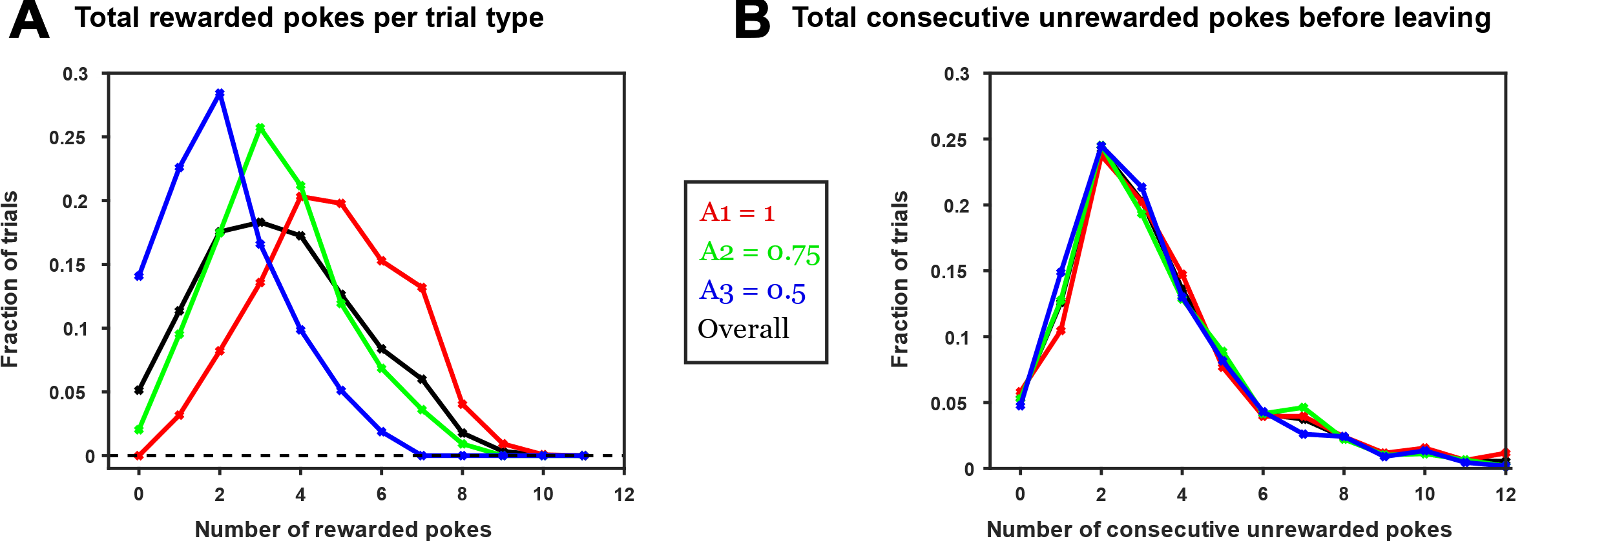
Animals make inference based decision

Slide 9
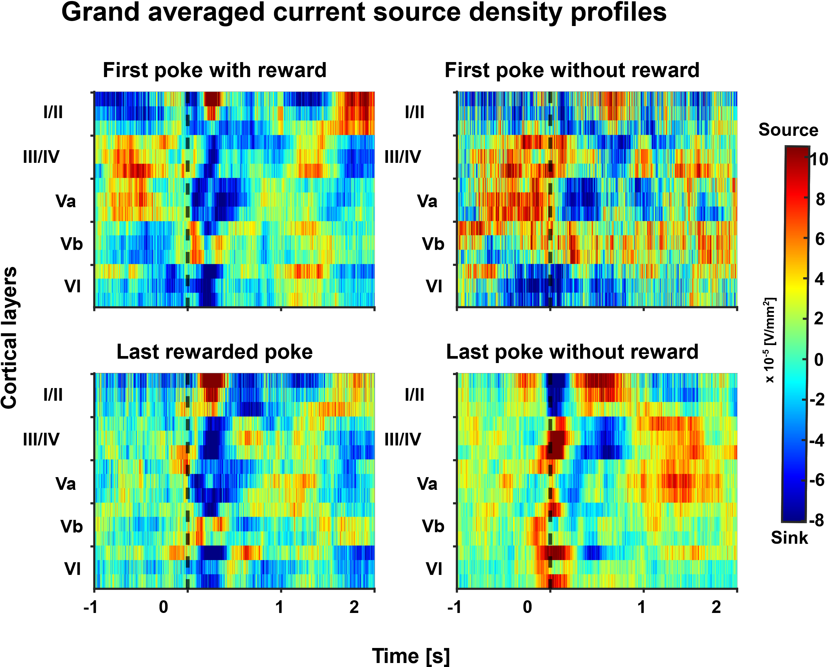
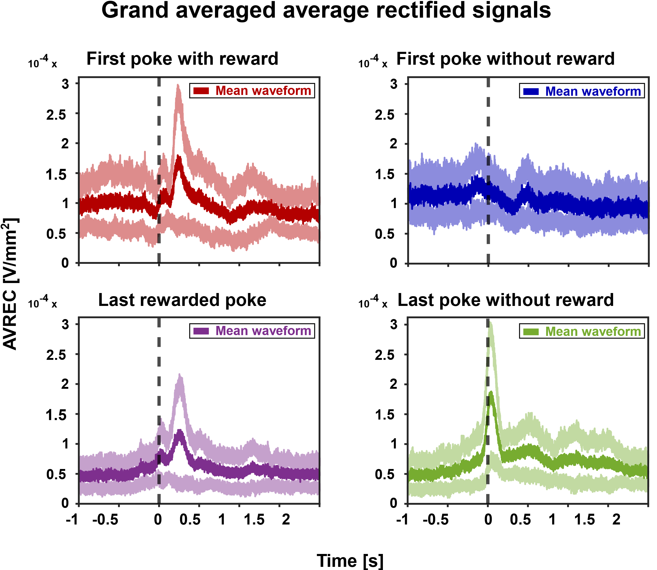
Distinct motor and reward related frontal activity

Slide 10
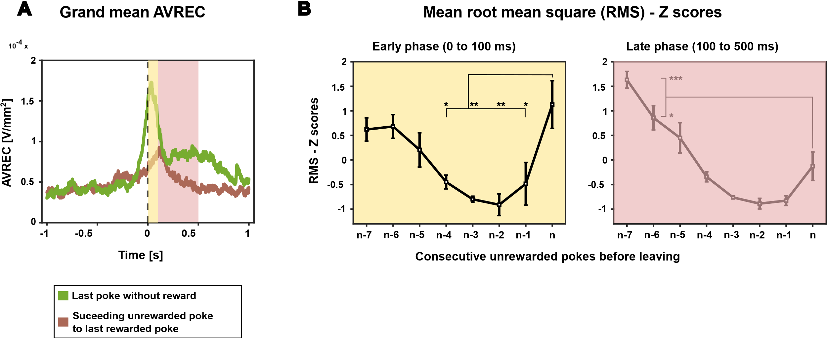
Shifts in frontal activity patterns: Exploitation to exploration

Slide 11
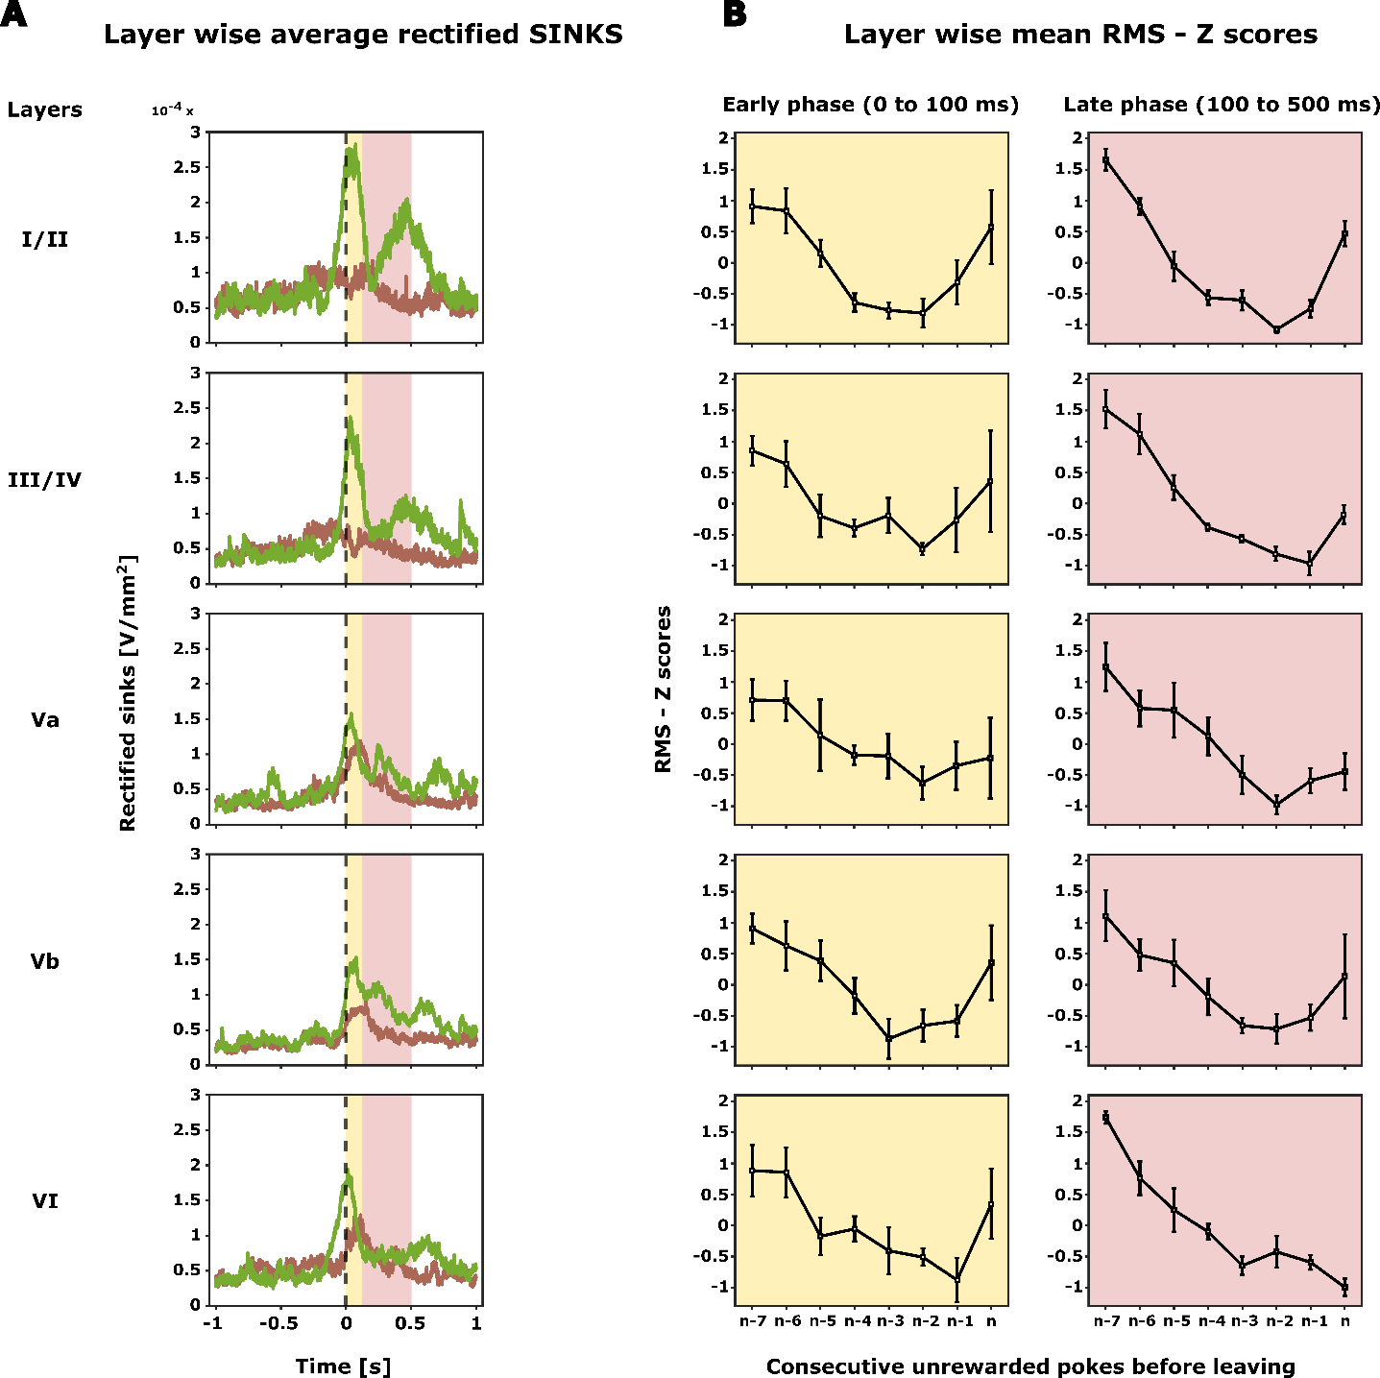
Layer specific frontal motor and reward related activity

Slide 12
Summary

Slide 13
Future directions

Slide 14
Why this lab?

Slide 15
Thank you

